Slide 1
Welcome to
The AMOS Demo Day!
Dirk Riehle, Univ. Erlangen
AMOS C02
Licensed under CC BY 4.0 International

Slide 2
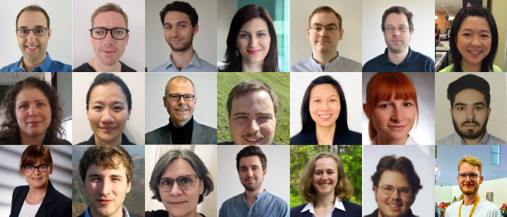
The Professorship of Open Source Software

Slide 3
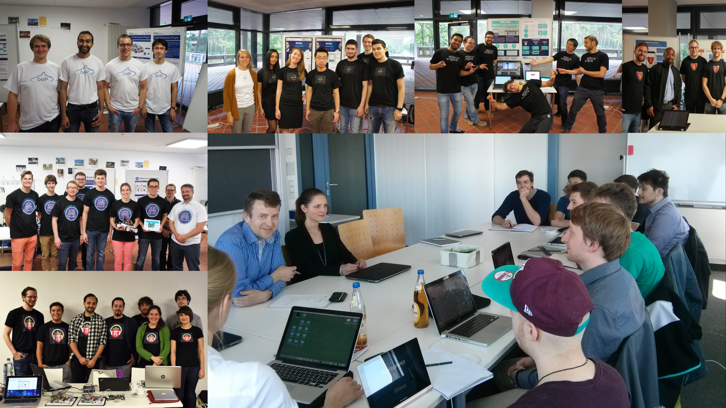

Slide 4
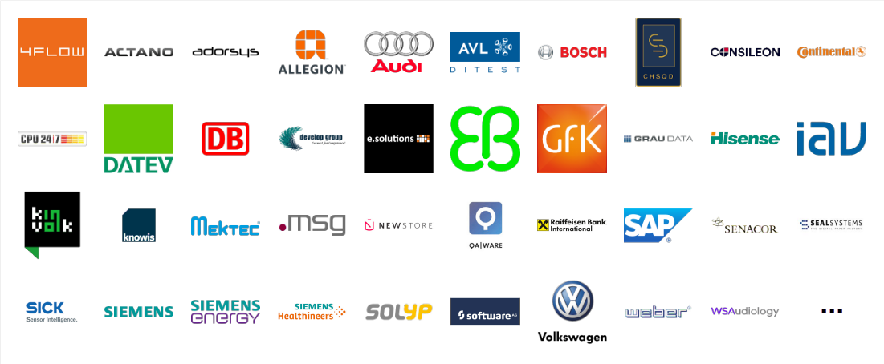
Industry Partners

Slide 5



Participating Universities

Slide 6
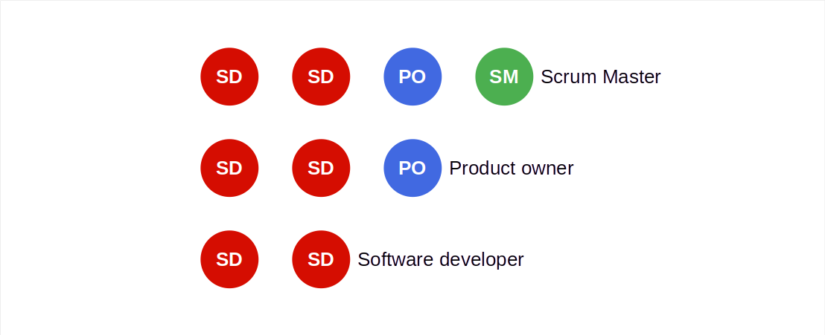
Distributed Scrum Teams

Slide 7
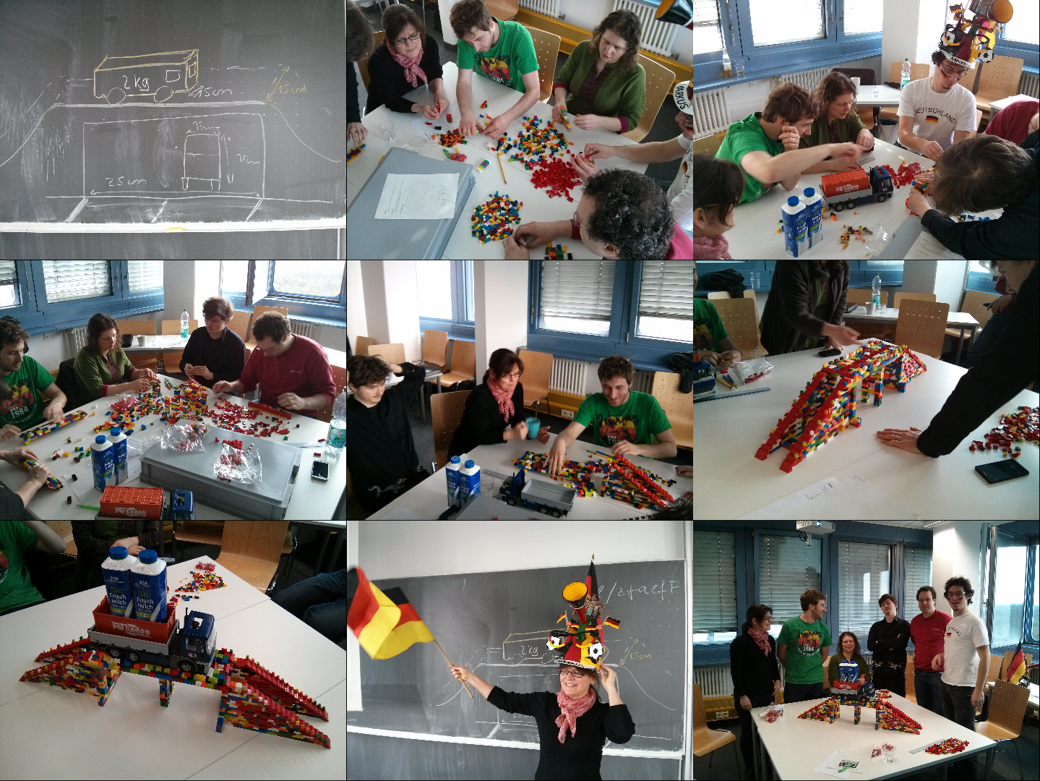
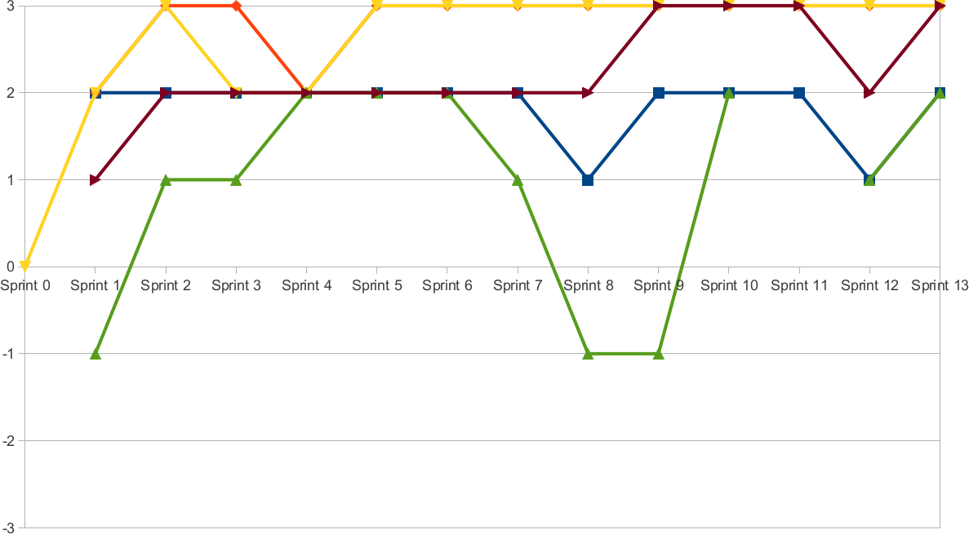
Project Coaching and Support

Slide 8
Demo Day Schedule
Time | Duration | Responsible | Title | Room
10:15 | 10 min | Riehle | Introduction | Main room
10:25 | 10 min | Teams | One slide summary | Main room
10:35 | 20 min | Teams | Demo | Demo rooms
10:55 | 20 min | Teams | Demo | Demo rooms
11:15 | 20 min | Teams | Demo | Demo rooms
11:35 | 20 min | Teams | Demo | Demo rooms
11:55 | 5 min | Riehle | Conclusions | Main room

Slide 9
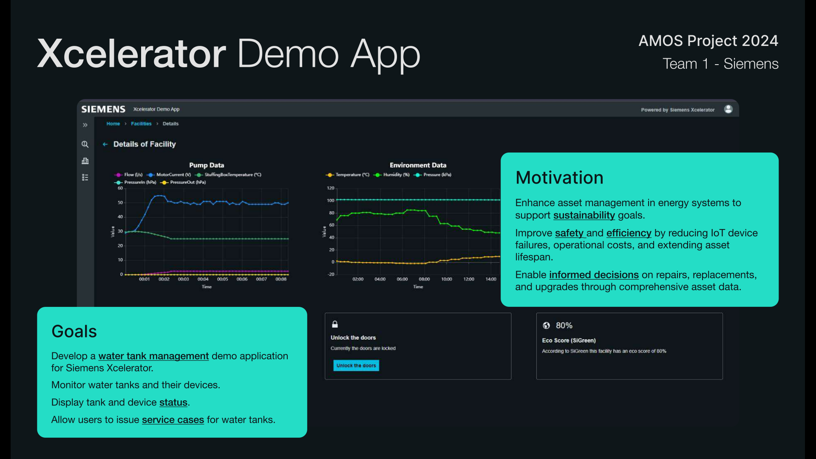

Slide 10
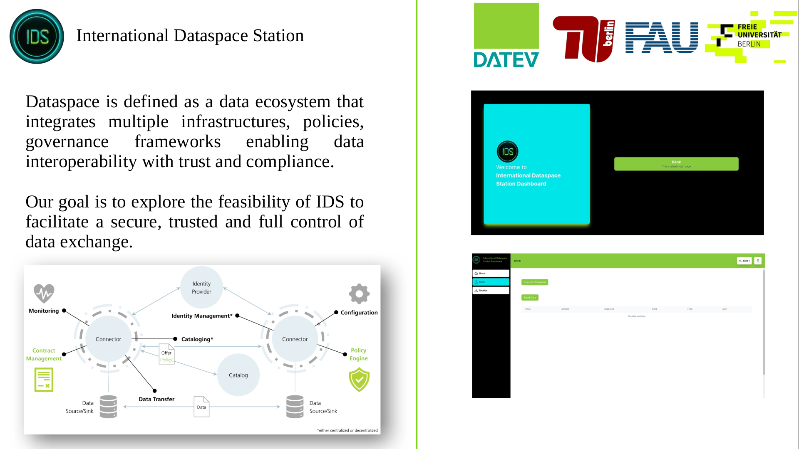

Slide 11
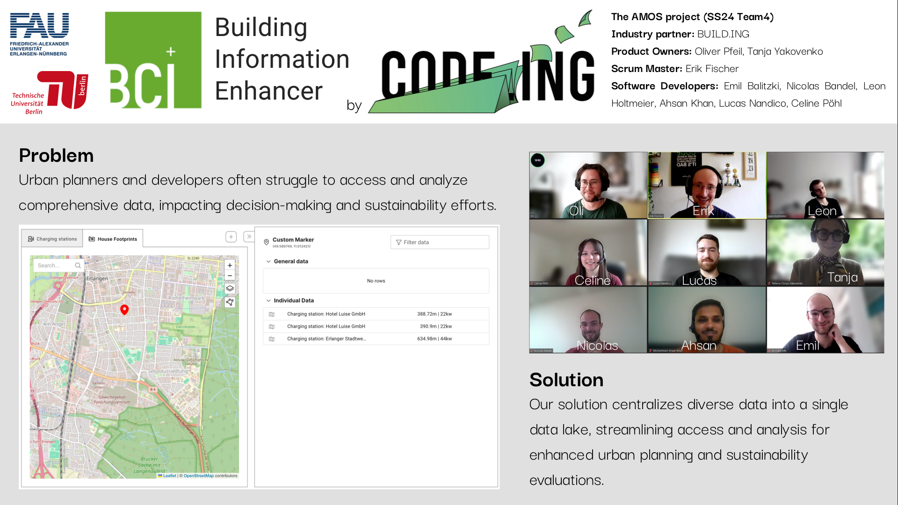

Slide 12
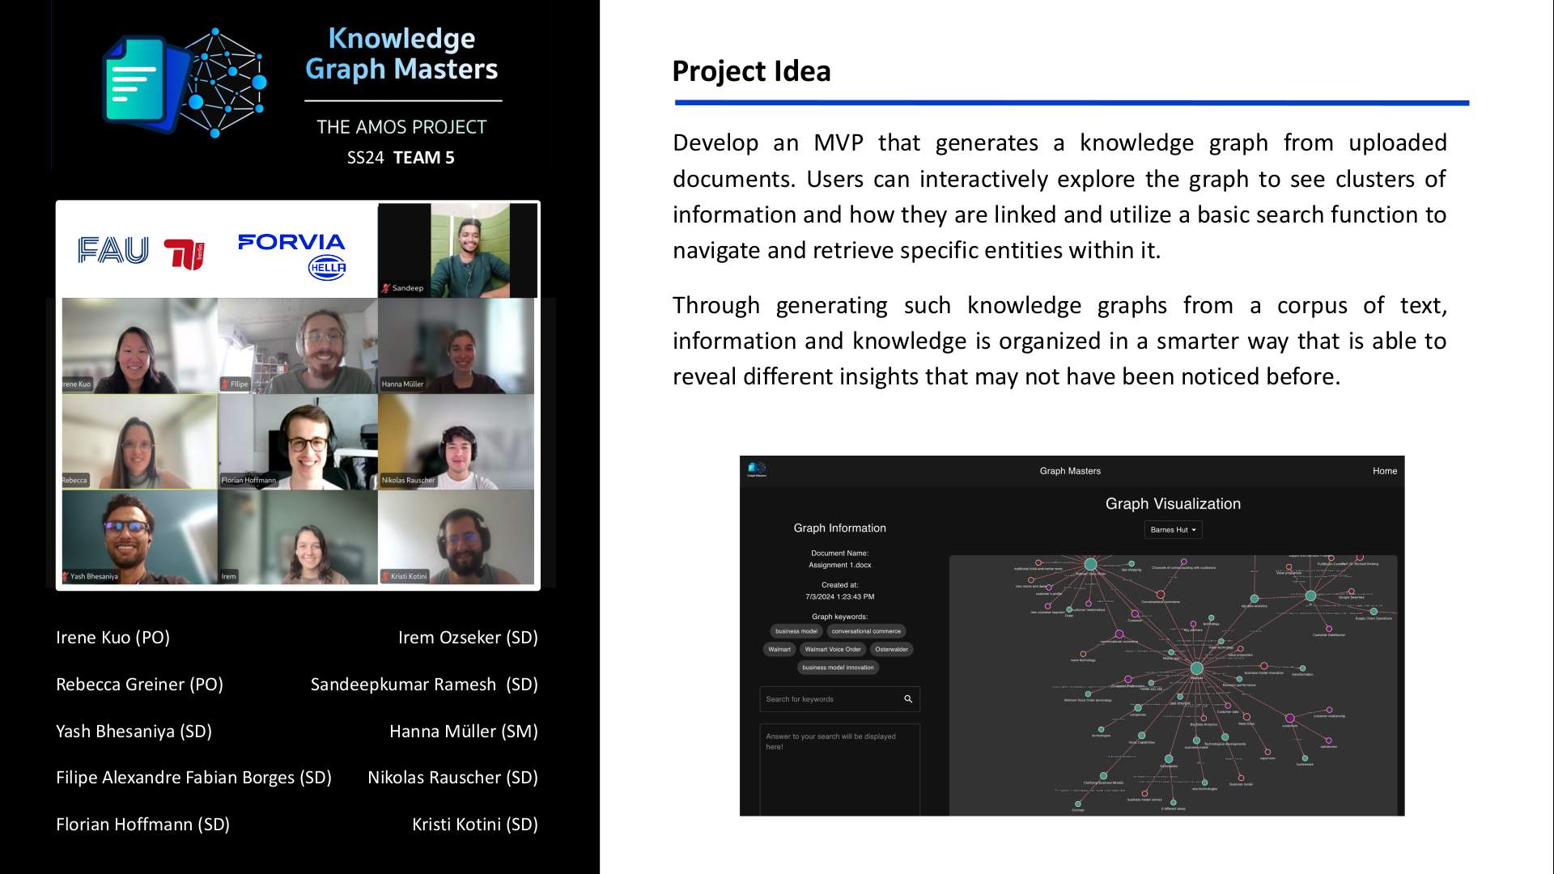

Slide 13
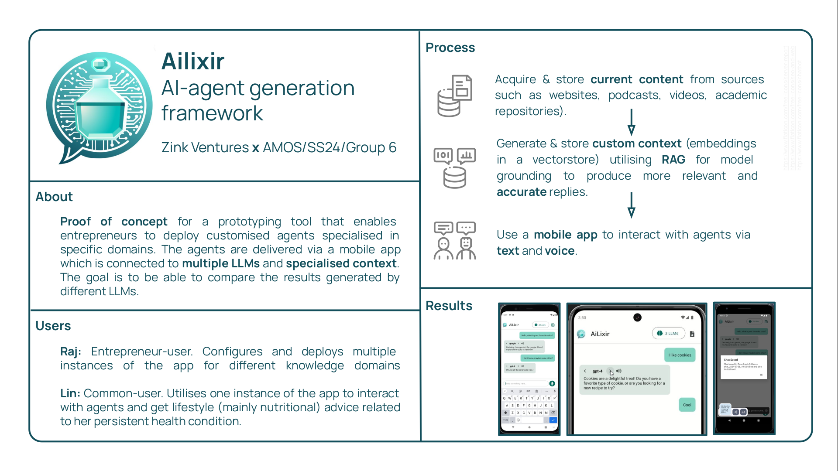

Slide 14
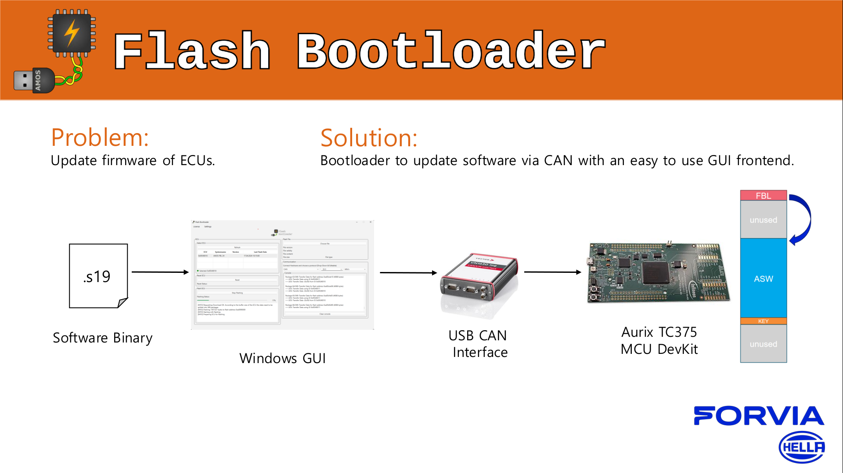

Slide 15


Slide 16
This Semester’s Projects
# | Project | Industry Partner
1 | Xcelerator demo app | Siemens
2 | International dataspace station | DATEV
3 | – | –
4 | Building information enhancer | BUILD.ING
5 | Knowledge graph extractor | HELLA
6 | Health AI framework | Zink
7 | Updating flash boot loader | Hella
8 | Cloud native LLM | Kubermatic

Slide 17
Let’s go see the demos!
Please join a breakout session

Slide 18
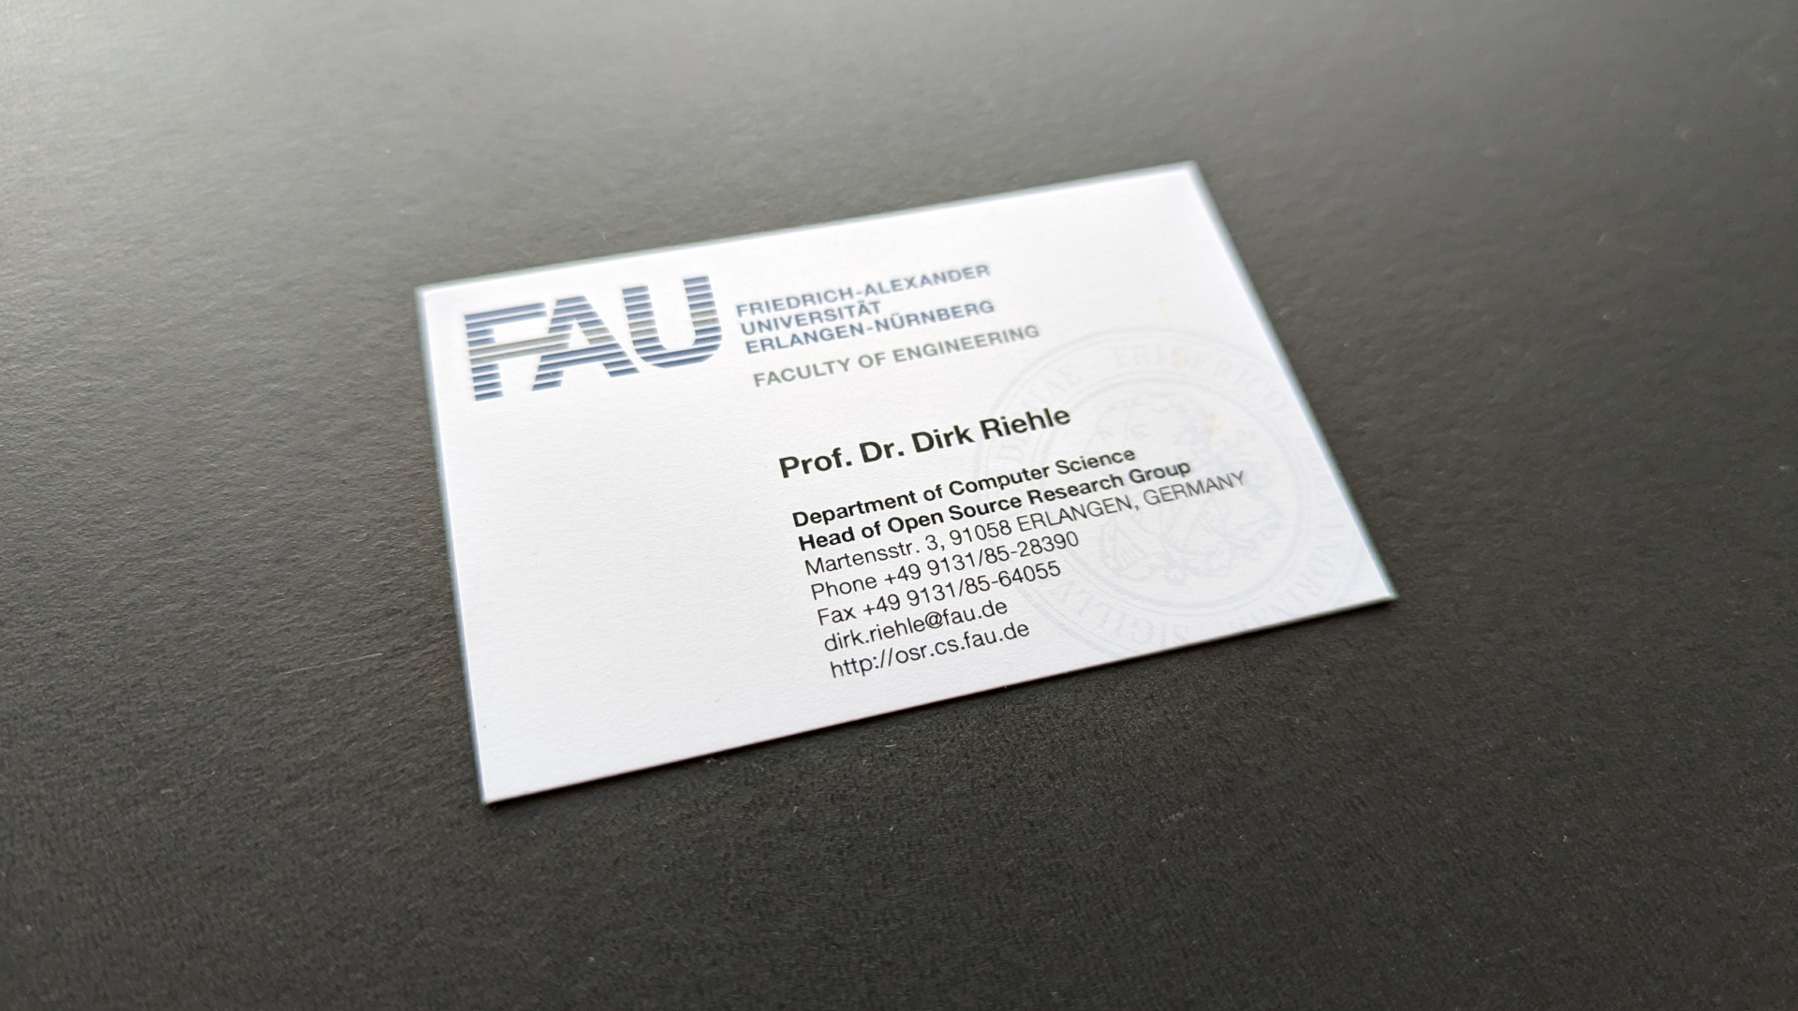

Slide 19
Thank you! Any questions?
dirk.riehle@fau.de – https://oss.cs.fau.de
dirk@riehle.org – https://dirkriehle.com – @dirkriehle

Slide 20
Legal Notices
License
Licensed under the CC BY 4.0 International license
Copyright
© Copyright 2009, 2024 Dirk Riehle, some rights reserved

